Slide 1
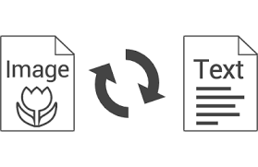
CUSTOM OCR
ASHA SANDEEP
NOIDA
DIGICHROME ACADEMY
Project-10
submission date:-20th march,2025
To Nexthikes@info

Slide 2
Objective
The objective of this OCR (Optical Character Recognition) project is to develop a Streamlit-based web application that allows users to extract text from images using EasyOCR. The app enhances text recognition through image preprocessing, including grayscale conversion, resizing, Gaussian blur, and bounding box visualization around detected text.

Slide 3
Metodology
🔹 Preprocessing Steps for Better OCR Accuracy
1 Convert image to grayscale
2 Remove noise (Gaussian Blur, Median Blur)
3 Apply binarization (Otsu’s / Adaptive Thresholding)
4 Resize and scale the image properly
5 Apply morphological transformations (Dilation & Erosion)
6 Enhance contrast (Histogram Equalization / CLAHE)
7 Detect edges & find contours (Canny, Sobel Filters)
8 Streamlit web app create with the help of easyocr

Slide 4
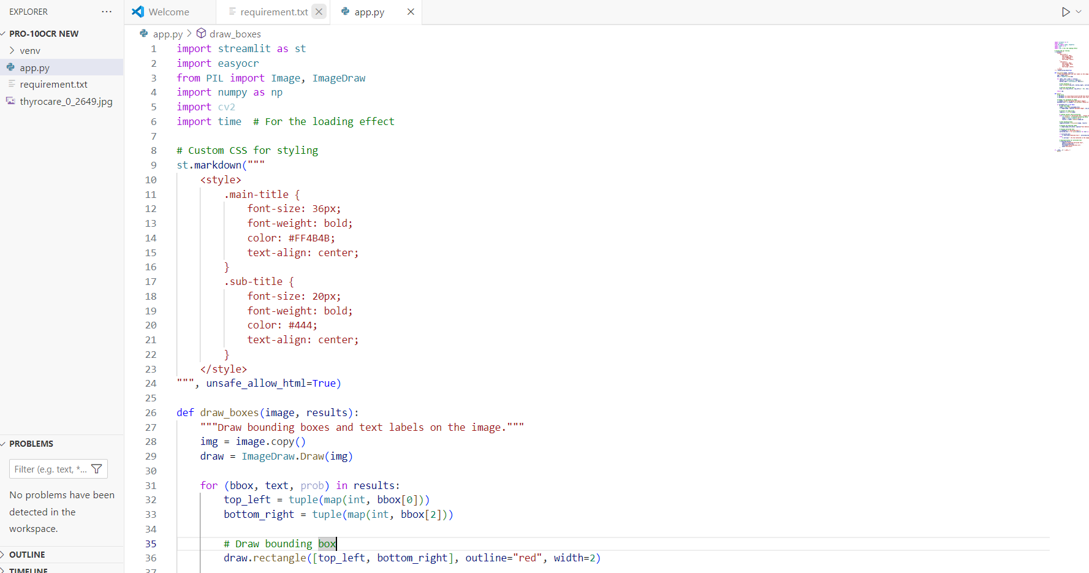
STEP 1 Install required liabraries
Run the following commands in your terminal:
bash
pip install streamlit easyocr numpy opencv-python pillow
If pip is not recognized, try:
bash
python -m pip install streamlit easyocr numpy opencv-python pillow

Slide 5
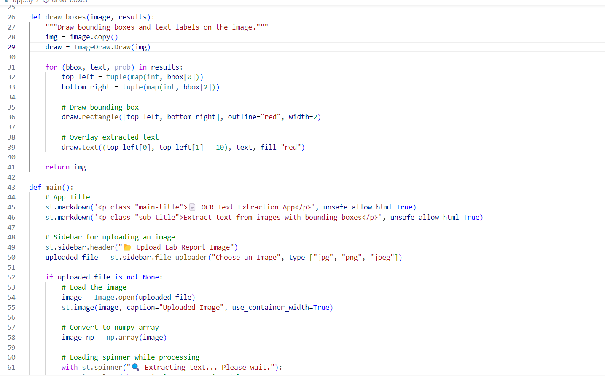
STEP 2 writing the python codes
1 Import required libraries
2 Create a function to draw bounding boxes
3 Load and process the image using EasyOCR
4 Display extracted text and allow download

Slide 6
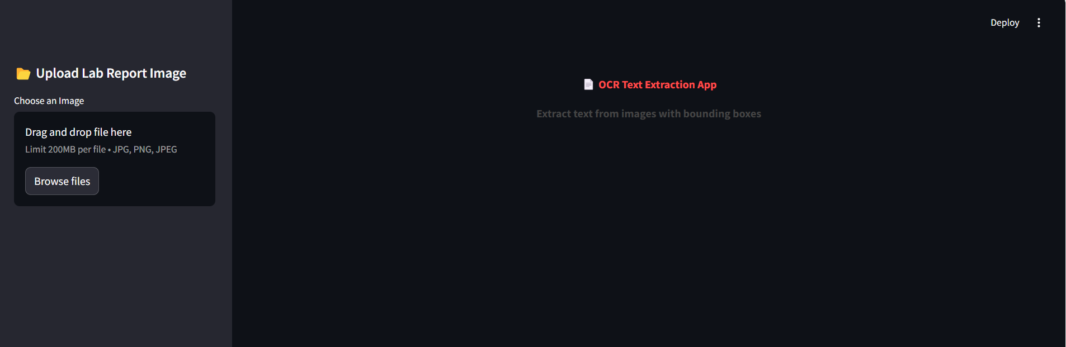
STEP-3 writing the code
import streamlit as st
import easyocr
from PIL import Image, ImageDraw
import numpy as np
def main():
st.title('OCR Text Extraction')
uploaded_file = st.file_uploader('Upload an Image')
STEP-4To launch my Streamlit OCR app
streamlit run app.py
You can now view your Streamlit app in your browser.
http://localhost:8501/

Slide 7
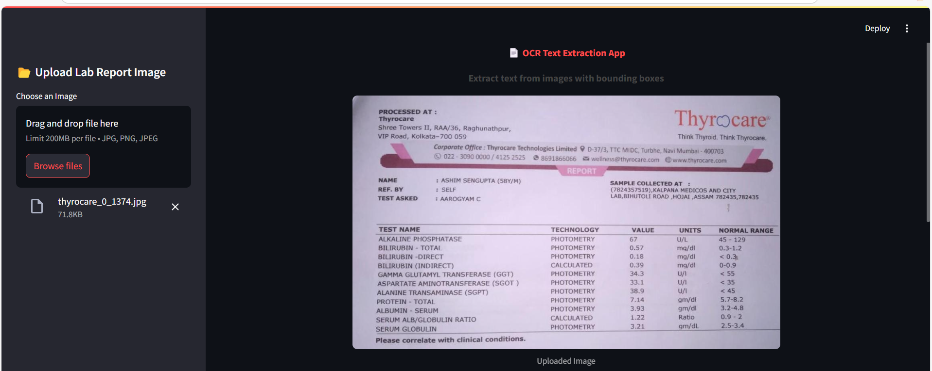
Here I click the browse files button and uplaod the image from folder where i store my dataset and the image show in this page.

Slide 8
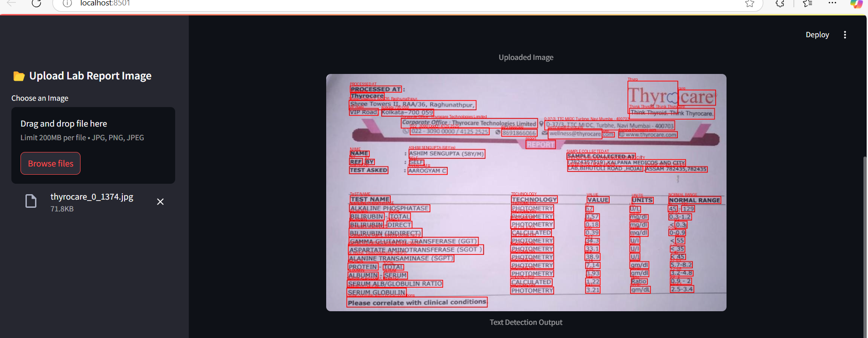
After uploaded image’s text will detected and Text Detection output will show here by creating the bounding box on all text.

Slide 9
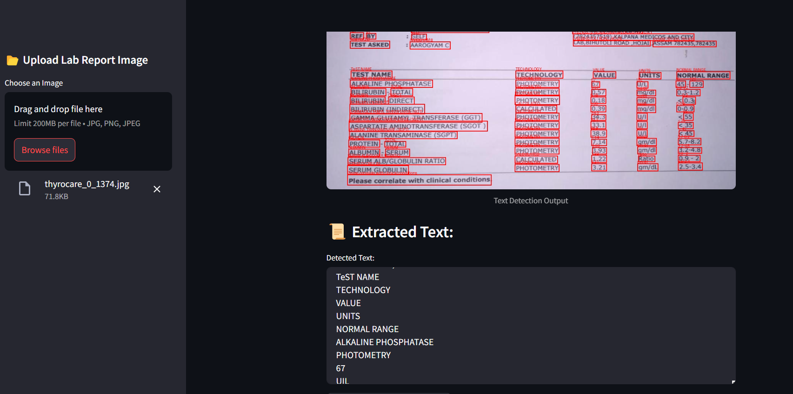
In this pic text detected and and show clearly we have to scroll here to show to text.

Slide 10
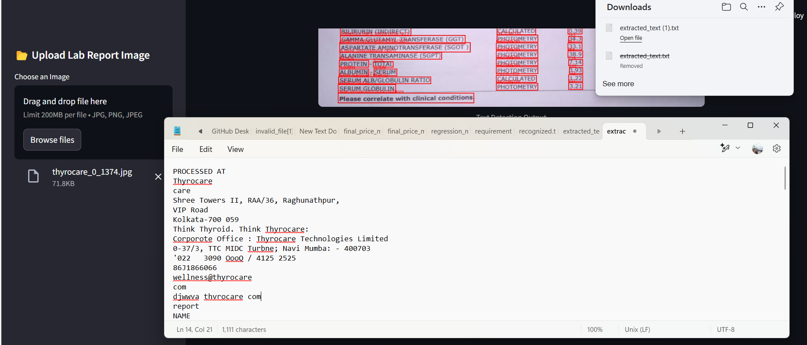
I have created on button of download the extracted text in text file here we can also edit the text and save the file in any where option will get.

Slide 11
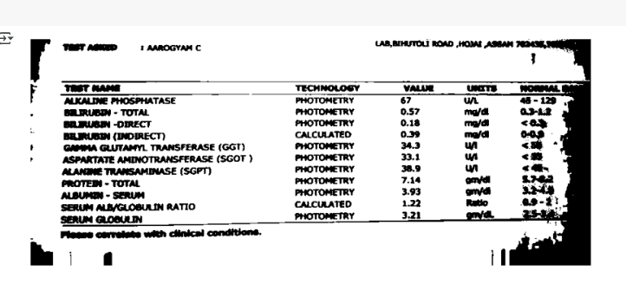
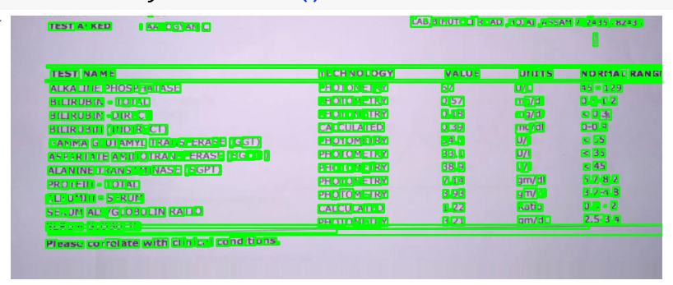
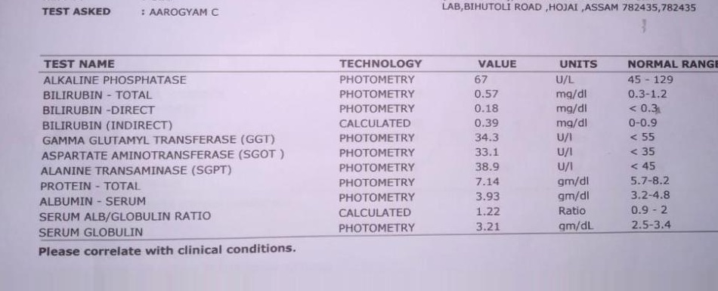
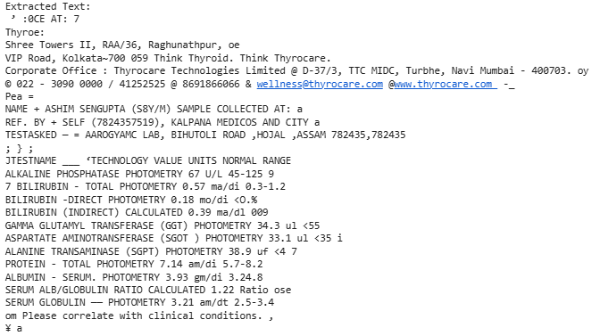
Keyfeatures
after preprocessing the image i got the solution of extract the text from image

Slide 12
Challenges faced
I faced challenges
Image Quality Issues
Noisy Background & Complex Layouts
Preprocessing Difficulties
Bounding Box Accuracy
OCR Engine Limitations only 200MB per file

Slide 13
Solution
I got the solution from geeks for geeks,You tube ,google.Finally my ocr engine is ready to upload the Images and convert it into the Text.

Slide 14
Results and achievement
My Streamlit OCR App is ready! I can try uploading different images and testing the text extraction.but the limit is only 200 MB per file.

Slide 15
Conclusion
This OCR project provides an easy-to-use interface for extracting text from images using EasyOCR and OpenCV. It includes preprocessing steps to improve text recognition accuracy and offers a user-friendly way to download extracted text.Now we have fully functional Image -to-Text OCR application in python using Streamlit.We have also explored multiple OCR solution-from classical open -source Tesseract to EasyOCR and even the potential of LLM-based OCR like GPT-4 Vision.Feel free to customize the interface ,enhance language detection,or integrate advanced ML- based OCR solution .

Slide 16


